Slide 1
Earthquake Prediction Using Machine Learning Models
By - Group 5
Jay Dale
Renita D’silva
Sally Wei

Slide 2
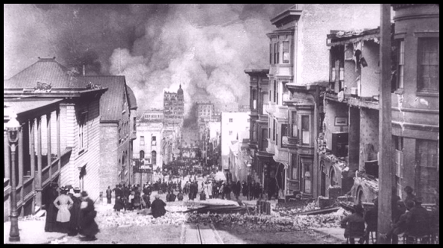
Project Background
High value
Difficult
Local
Steinbrugge Collection, UC Berkeley Earthquake Engineering Research Center
Notes:
Our project is earthquake forecasting, which we accomplish by predicting earthquake magnitude in future years in a time spans of 1-year, 5-year, 10-year. Real-time data.

Slide 3
Project Requirements
Historical records, earthquake catalog
Completeness
Accessibility
Interpretable models
Ease of integration
Flexibility for real-time monitoring
Runtime
Real-time

Slide 4
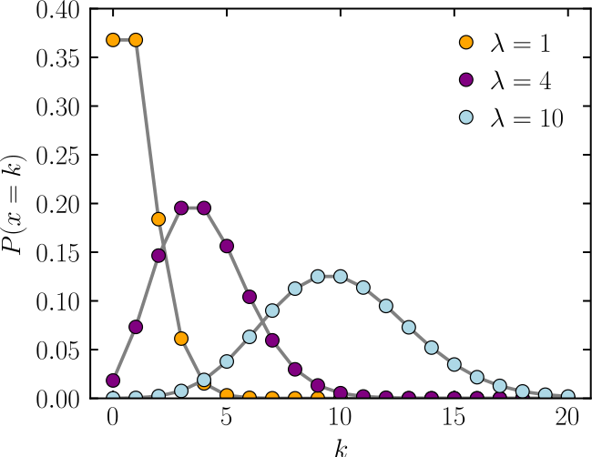
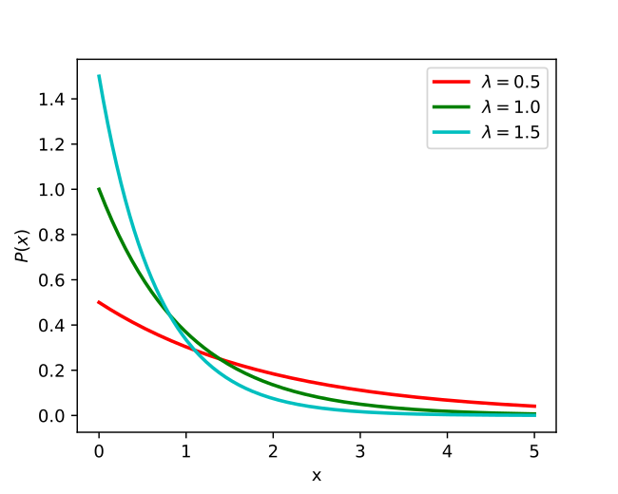
Technology & Literature Survey
Simulation vs. frequency analysis
ETAS/Poisson model
Exponential model
Long-term vs. short-term model
Time-independent vs. time-dependent
Ellsworth (1995), Jordan & Jones (2010), Baranov, et al. (2019)
https://en.wikipedia.org/wiki/Poisson_distribution
https://en.wikipedia.org/wiki/Exponential_distribution
Notes:
Ellsworth, W. L. (1995) presents two approaches to long-term earthquake forecasting: one is the simulation of earthquakes, the other is the analysis of frequencies of smaller earthquakes.
Forecasting can be done using a short-term model or a long-term model, where Jordan & Jones (2010) performed a review of existing methods and noted that short-term models presented a probability gain over long-term models Additionally, they noted a shift from using time-independent models to using time-dependent models, which again produced results with higher probabilities.
Time-depensent models
Built on to me-independent models
And add kinetic modeling of fault strain from sources like GPS data

Slide 5
Technology & Literature Survey
 | Model | Focus | Dataset
Helmsletter & Werner (2012) | Long-term Time-independent Frequency analysis | M >= 2.0 Depth <= 100km | 30 years ANSS catalog (California only)
Zhuang (2011) | Short-term Time-independent ETAS | M >= 4.0 Depth <= 100km | 38 years JMA earthquake catalog (Japan)
Notes:
ANSS (Advanced National Seismic System), collects from all over the US.
JMA (Japan Meteorological Agency)
PDE Preliminary Determinations of Epicenters

Slide 6
Technology & Literature Survey
 | Model | Focus | Dataset
Kagan & Jackson (2010) | 1 short-term & 1 long-term model Time-dependent Frequency analysis | M >= 4.0 Depth <= 25km | 5 years ANSS and PDE catalogs (Nevada & California)
Field et. al. (2015) | Long-term Time-dependent Elastic-rebound, aperiodicity models | Monte-Carlo simulations | UCERF3 fault, crust, event, & probability models (California)
Baranov et al. (2019) | Short-term Time-dependent ETAS and Exponential | M >= 4.0 (ΔM>=1.5) | Up to 1 year after each of 3 major earthquakes
Notes:
Elastic-rebound-motivated probabilities for modelling earthquake productivity. Modelled Field et. al from Uniform California Earthquake Rupture Forecast (UCERF) uses a completely simulated approach, estimating events with models for fault activity, crust deformation, event rate, and probability.

Slide 7
Technology & Literature Survey
 | Model | Focus | Dataset
Gitis & Derendyaev (2019) | Short-term Time-independent Regression | M >= 2.7 Depth <= 160km | 9 years Mediterranean & California
Ahuja & Pasari (2022) | Short-term Time-independent Frequency analysis ANN with Adam | M >= 4.0 | 30 years Himalayan data
Notes:
ANSS (Advanced National Seismic System), collects from all over the US.
JMA (Japan Meteorological Agency)
PDE Preliminary Determinations of Epicenters

Slide 8
Project Resource Requirements
Tools and applications | Resource type | Cost estimate | Duration | Objective
Snowflake | Software | Free | 3 months | Data Storage
Jupyter Notebook | Software | Free | 3 months | Data preprocessing
Scikit Learn, Kera, Tensorflow | Software | Free | 3 months | Machine learning framework and library
GitHub | Software | Free | 3 months | Storing in repository
Tableau Desktop | Software | Free(Student License) | 3 months | Visualizations
Numpy, Pandas | Software | Free | 3 months | Libraries

Slide 9
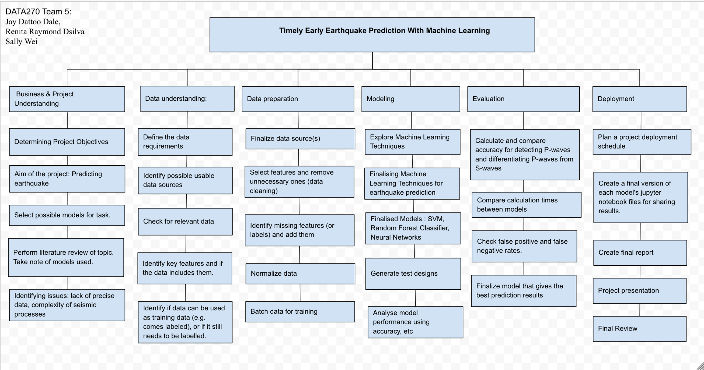
Project Plan - Work Breakdown Structure

Slide 10
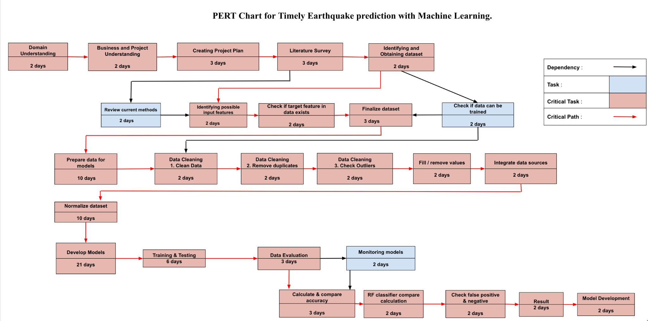
Project Plan - PERT Chart

Slide 11
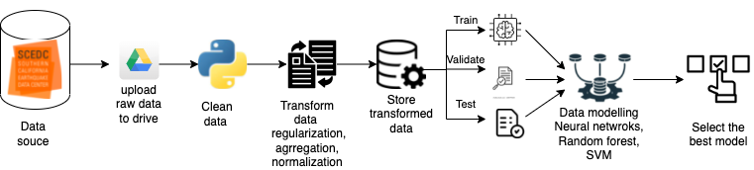
Project Architecture

Slide 12
Project Data Preparation
The dataset is sourced from Southern California Earthquake Data Center which provides with earthquake data starting from 1980 - present date.
The data is combined from Seismographic networks of US Geological Survey, UC Berkeley, Menlo Park & USGS, The Seismological Laboratory, University of Nevada, Reno.
The data is collected by a real-time computer that monitors the Earth for any earthquake occurrences and seismic signals.
Monitored using radio and landlines from 600 remote locations. If any earthquake is detected the data is sent to the web pages using real-time computers and therefore the data sources have data starting from 1980 to present day.

Slide 13
Data Parameters
1. Date
2. Time
3. Event type
4. Geographical type (l,t,r)
5. Type of magnitude
6. Magnitude
7. Latitude
8. Longitude
9. Depth
10. Quality
11. Event ID
12. Number of picked phases
13. Number of grams

Slide 14
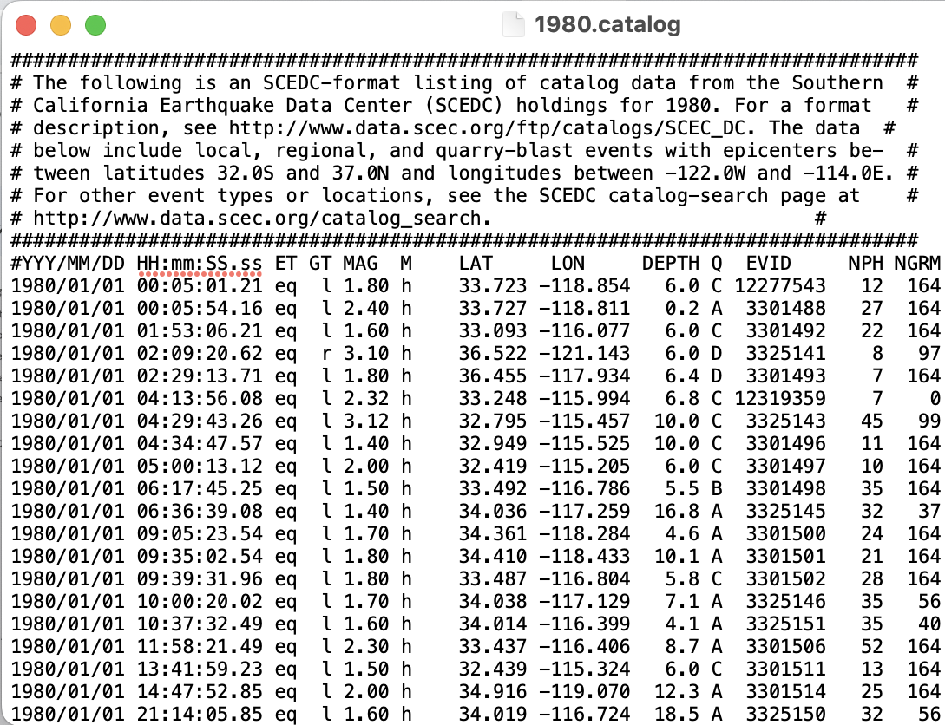
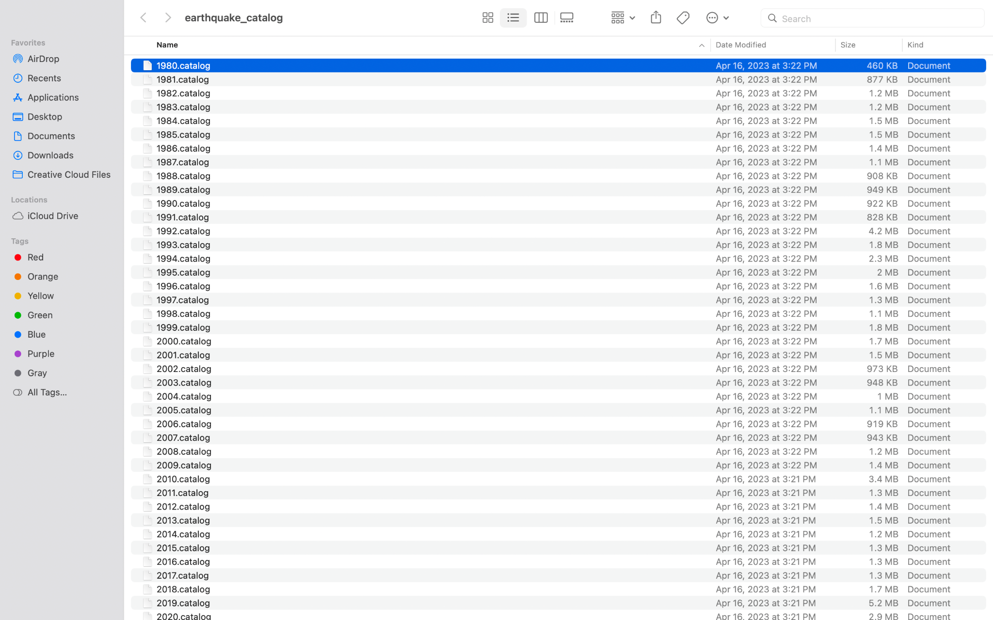
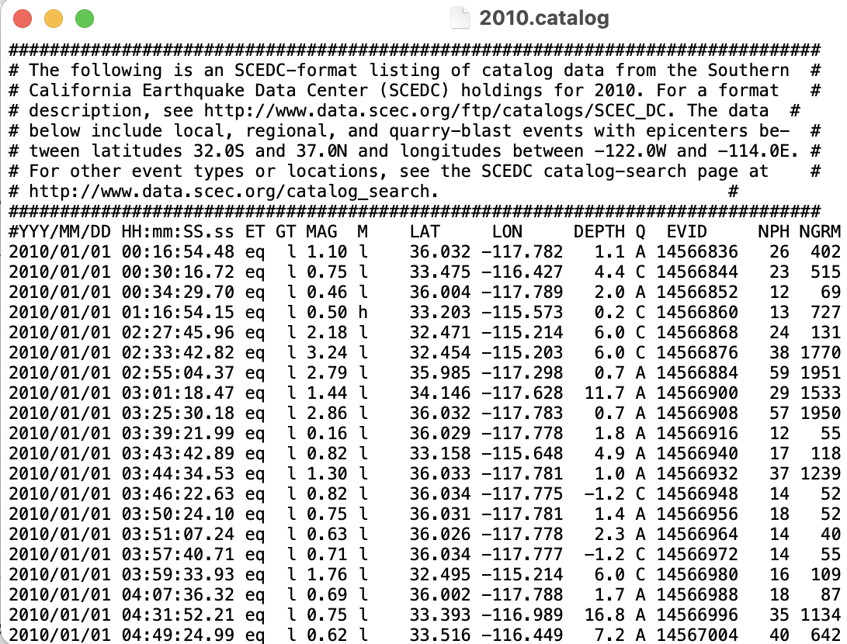
Raw Data

Slide 15
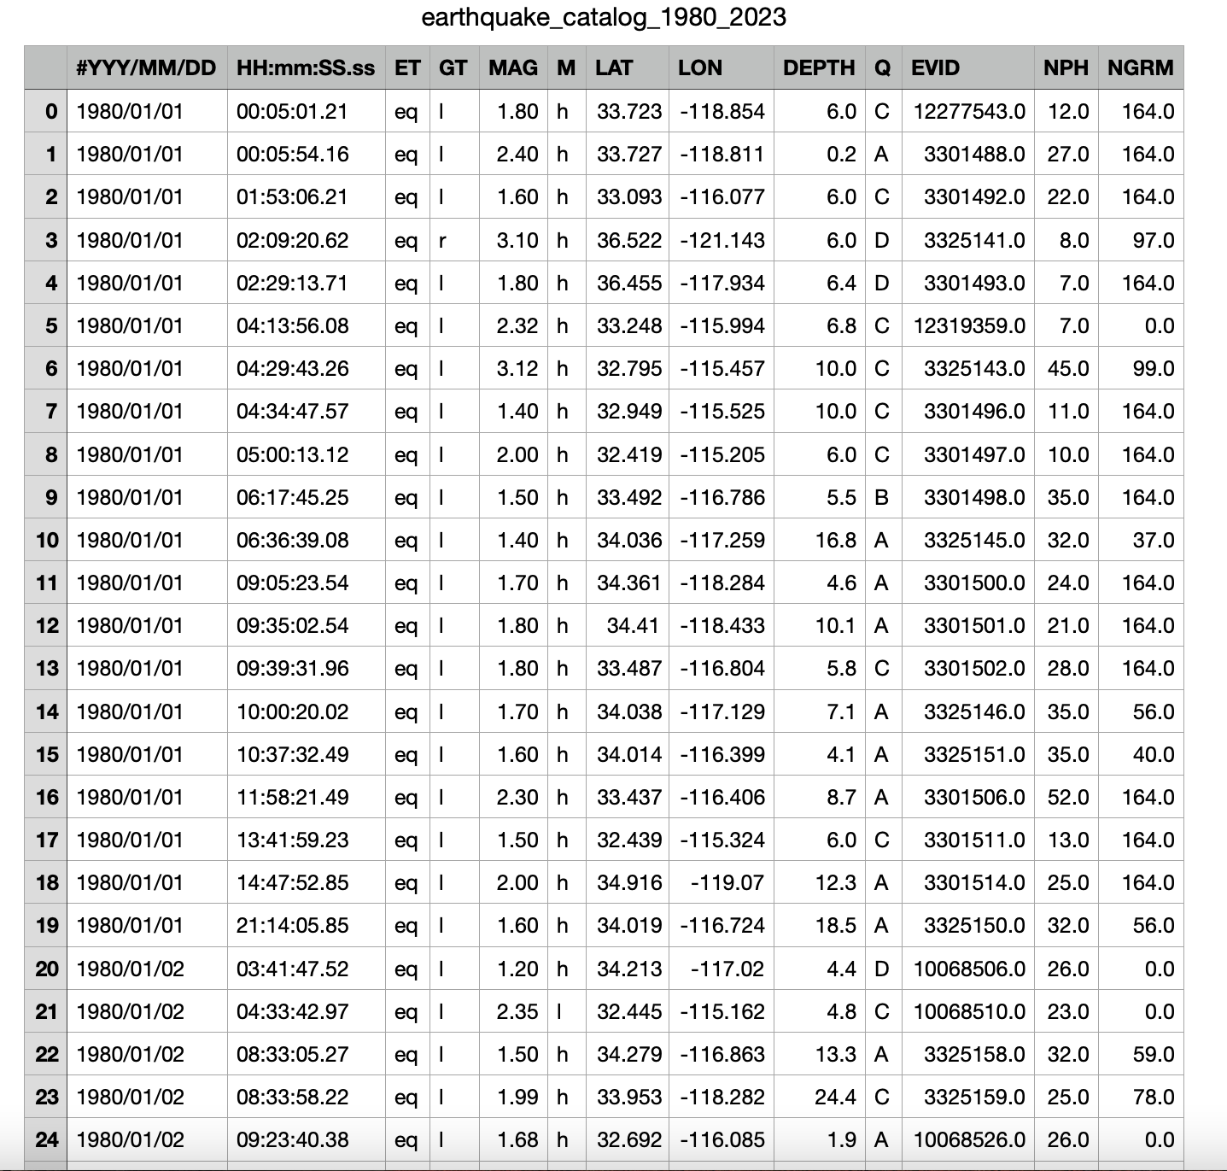
Combined Raw Data from 1980 - 2023

Slide 16
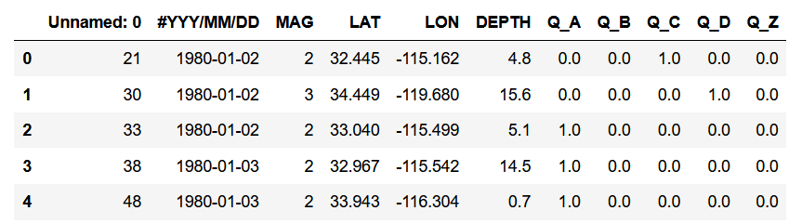
Pre-processed Data

Slide 17
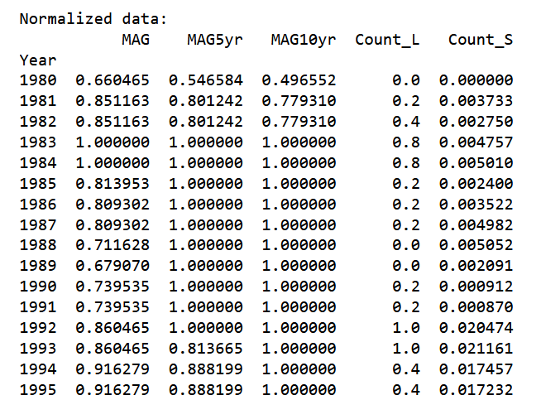
Test Dataset
80% Training | 10% Val | 10% Test

Slide 18
MODEL SELECTION
Selecting the right machine learning models is critical for developing an accurate and reliable solution for a project.
SVM, Random Forest, and Neural Network models were selected based on their ability to handle the features in our dataset, such as earthquake magnitude, location, time, and depth.
The dataset was imbalanced, which means there were significantly more non-earthquake events than actual earthquake events, so techniques were used to address this issue and improve the performance of the models.
Notes:
When selecting machine learning models for a project, we carefully consider the characteristics of the dataset and the problem being addressed. In our project, we selected SVM, Random Forest, and Neural Network models based on their ability to handle the features in our dataset, such as earthquake magnitude, location, time, and depth. So We evaluated these models using various performance metrics such as accuracy, and MSE and identified the best-performing model based on these metrics.
SVM is known for its ability to handle high-dimensional data and perform well with both linear and non-linear boundaries.
Random Forests are powerful ensemble models that can handle a large number of features and are less prone to overfitting.
Neural Networks are known for their ability to model complex relationships between variables and are well-suited for time-series data. We believed that by selecting these models, we could leverage their strengths to make accurate predictions about future earthquakes. However, we also noted that your dataset was imbalanced, with significantly more non-earthquake events than actual earthquake events. Overall our model selection process involved consideration of the characteristics of the dataset, evaluation of the performance metrics, and application of techniques to address any imbalances in the dataset.
REGRESSION VS CLASSIFICATION

Slide 19
INNOVATION
Created additional columns in the dataset to capture the temporal and spatial patterns of earthquakes.
Conducted feature importance analysis to identify the most important features that contributed to earthquake prediction Fine-tuned the models based on the results of the feature importance analysis.
These innovative techniques helped us to improve the accuracy and reliability of our models, which are critical for early earthquake prediction.
Notes:
To address the challenges, we created additional columns in our dataset. Specifically, we created four new columns: L, which denotes large earthquakes over 5.5 magnitude; S, which denotes small earthquakes below 5.5 magnitude; MAG5, which represents the rolling maximum magnitude over 5 years; and MAG10, which represents the rolling maximum magnitude over 10 years. These columns helped us to capture the temporal and spatial patterns of earthquakes and improve the performance of our machine learning models.
Temporal patterns refer to the patterns or trends that occur over time. In the context of earthquake prediction, temporal patterns may include the frequency and intensity of past earthquakes in a specific region, or the occurrence of earthquakes during certain times of the year. Spatial patterns, on the other hand, refer to the patterns or trends that occur in different geographic locations. In the context of earthquake prediction, spatial patterns may include the distribution of past earthquakes across different regions or the occurrence of earthquakes along specific fault lines. We used feature importance analysis to identify the most important features that contributed to earthquake prediction, which helped us to fine-tune the models and improve their performance."

Slide 20
COMPARING REGRESSION MODELS
Model | 1-year | 5-year | 10-year
Random Forest (MSE) | 0.0171 | 0.0438 | 0.0186
SVM (MSE) | 0.03397 | 0.03507 | 0.0124
Notes:
This table shows the performance of different models on a dataset with different time horizons. FOR this model, we have the mean squared error (MSE) for three different time horizons: 1-year, 5-year, and 10-year.
Lower MSE values indicate better performance, as they indicate that the model's predictions are closer to the true values in the test set.
MSE = (1/n) * Σ(yi - y^i)^2
Where n is the total number of observations, yi is the actual value of the i-th observation, and y^i is the predicted value of the i-th observation. The formula computes the squared difference between the actual and predicted values for each observation, adds up all these squared differences, and then takes the average of these values to get the final MSE. The lower the value of MSE, the better the performance of the model.

Slide 21
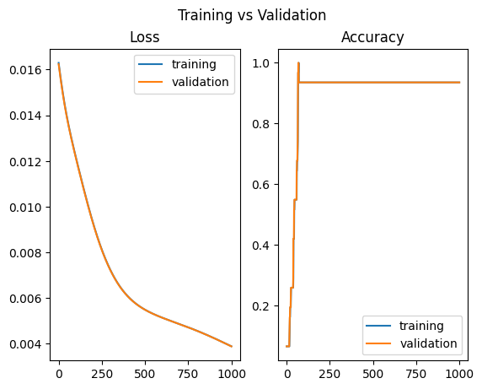
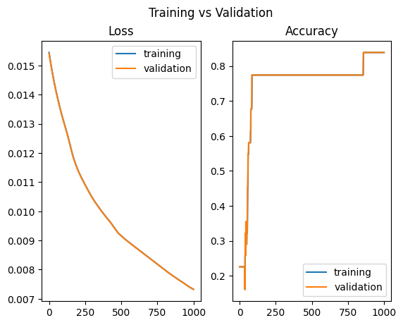
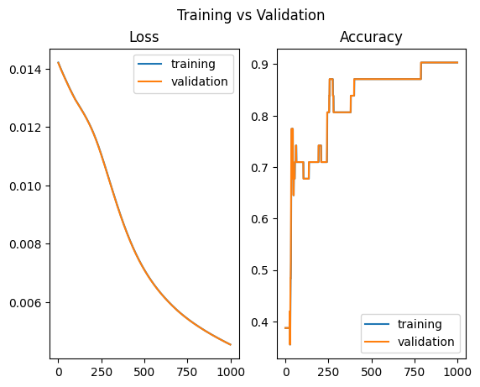
CLASSIFICATION MODEL
Model | 1-year | 5-year | 10-year
Neural Network (Test accuracy) | 0.935 | 0.839 | 0.90

Slide 22
CONCLUSION
Simple models
Fast runtime to handle real-time data
Fast training time for rapid re-training
Simple pipeline makes it easy to integrate into other programs
Good prediction results for selected time frames

Slide 23
FUTURE WORK
Additional features, like fault strain, time-dependent model
Simulated data
Test different models like LSTM for sequence processing

Slide 24
THANK YOU !

Slide 25
References
Ahuja, A. & Pasari, S. (2022) Earthquake Forecasting in the Himalayas Artificial Neural Networks. Disaster Management in the Complex Himalayan Terrains, 141–152. “Geography of the Physical Environment.” Springer, Cham. https://doi.org/10.1007/978-3-030-89308-8_10
Baranov, S.V., Gvishiani, A.D., Narteau, C., Shebalin, P.N. (2019) Epidemic type aftershock sequence exponential productivity. Russian Journal of Earth Sciences, 19, Article: ES6003. https://doi.org/10.2205/2019ES000695
Ebel, J.E., Chambers, D.W., Kafka, A.L., Baglivo, J.A. (2007). Non-Poissonian Earthquake Clustering and the Hidden Markov Model as Bases for Earthquake Forecasting in California. Seismological Research Letters, 78(1): 57–65. https://doi.org/10.1785/gssrl.78.1.57
Ellsworth, W.L (1995). Characteristic earthquakes and long-term earthquake forecasts: Implications of central california seismicity. Urban Disaster Mitigation: The Role of Engineering and Technology,1-14. https://doi.org/10.1016/B978-008041920-6/50007-5

Slide 26
References
Field, E.H., Biasi, G.P, Bird, P., Dawson, T.E., Felzer, K.R., Jackson, D.D., Johnson, K.M., Jordan, T.H., Madden, C., Michael, A.J., Milner, K.R., Page, M.T., Parson, T., Powers, P.M., Shaw, B.E., Thatcher, W.R., Weldon, R.J., Zeng, Y. (2015). Long‐Term Time‐Dependent Probabilities for the Third Uniform California Earthquake Rupture Forecast (UCERF3). Bulletin of the Seismological Society of America, 105 (2A): 511–543. https://doi.org/10.1785/0120140093
Gitis, V.G, & Derendyaev, A.B. (2019). Machine Learning Methods for Seismic Hazards Forecast, Geosciences, 9(7), 308. https://doi.org/10.3390/geosciences9070308
Helmsletter, A. & Werner, M.J. (2012) Adaptive Spatiotemporal Smoothing of Seismicity for Long‐Term Earthquake Forecasts in California. Bulletin of the Seismological Society of America, 102(6): 2518–2529. https://doi.org/10.1785/0120120062

Slide 27
References
Jordan, T. H., & Jones, L. M. (2010). Operational Earthquake Forecasting: Some Thoughts on Why and How. Seismological Research Letters, 81(4), 571–574. https://doi.org/10.1785/gssrl.81.4.571
Kagan, Y.Y., Jackson, D.D. (2010). Short- and Long-Term Earthquake Forecasts for California and Nevada. Pure Appl. Geophys. 167, 685–692. https://doi.org/10.1007/s00024-010-0073-5
Zhuang, J.C. (2011). Long-term earthquake forecasts based on the epidemic-type aftershock sequence (ETAS) model for short-term clustering. 7th International Workshop in Statistical Seismology, 2 (1). https://doi.org/10.4081/rg.2012.e8

